Slide 1

MCA MAJOR PROJECT PRESENTATION 2022-2023
Jumble Word Game
by
Sri Nidhi Kumari [SBU210925]
Sweta Kumari [SBU210863]
Under the guidance of
Mr. AMIT KESHARI
Department of Computer Science and Engineering
Sarala Birla University, Ranchi, Jharkhand 835103

Slide 2
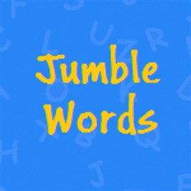
What is a Jumble Words Game?
A jumble word is a type of word puzzle in which a
set of scrambled letters must be rearranged
to from a meaningful word or phrase .

Slide 3
Content
Introduction
Advantage of Jumbles Words
Motivation
Requirement Specification
Basic Components of the Project
Working Principle of the Portal
Conclusion
Future Work

Slide 4
Benefits of Playing Jumble Words
Enhances vocabulary
When players are trying to make words out of jumbled letters ,it helps them to identify and learn new words, there by enhancing their vocabulary.
Increases focus and concentration
Playing jumble words requires players to concentrate and focus in order to figure out the correct words which helps increase their focus and concentration levels.
Makes learning fun
Jumble words is an interactive and engaging game that makes learning fun and enjoyable.
Encourages collaboration
It encourages collaboration among the players as they work together to figure out the rights words.

Slide 5
Introduction
A jumble word is a type of word puzzle in which a set of scrambled letters must be rearranged to from a meaningful word or phrase.
Jumble words are made up of a set of scrambled letters that must be rearranged to from a meaningful word or phrase.
1. TAR =ART 2. ONCEMTOPARRY=CONTEMPORARY 3. HIPIPLPNIES= PHILIPPINES 4. ISHOTRY=HISTORY

Slide 6
Motivation
JUMBLED LETTERS CHALLENGE
Motivation and their vocabulary mastery, it also helps students to understand the text while reading.
Using jumble letters technique in teaching and learning language is important especially in junior high school because it will not focuses on memorizing but remembering and practicing.
The teacher will let the students discover the words behind the jumbled letters.
1. TAR =ART 2. ONCEMTOPARRY=CONTEMPORARY 3. HIPIPLPNIES= PHILIPPINES 4. ISHOTRY=HISTORY
*What can be the topic from the words revealed in the challenge?

Slide 7
Requirement Specification
SYSTEM REQUIRMENT
HARDWARE
RAM : 4GB
Processor: Intel i3
SOFTWARE REQUIRMENT
OPERATING SYSTEM : Window 10/ Window 11
CODING LANGUAGE: python
EDITOR: VS CODE

Slide 8
FLOW CHAT OF JUMBLE WORD GAME
Start
Select the word
Animal ,Birds
Guess the word
Gain the score
Select the word
Fruits ,Color
Jump to next word

Slide 9
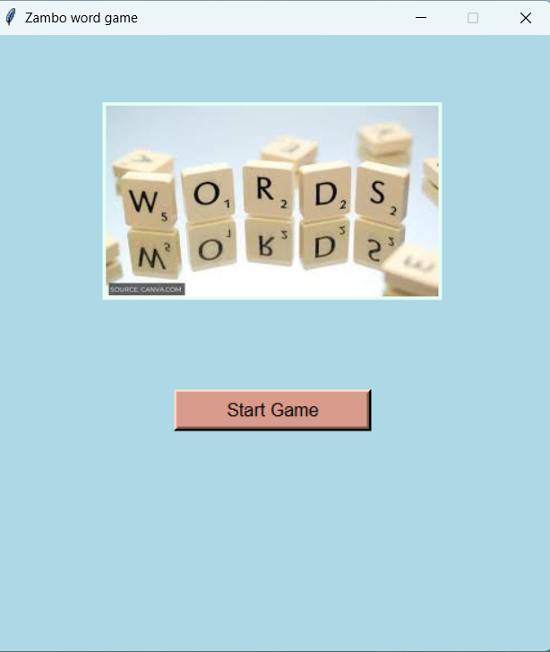
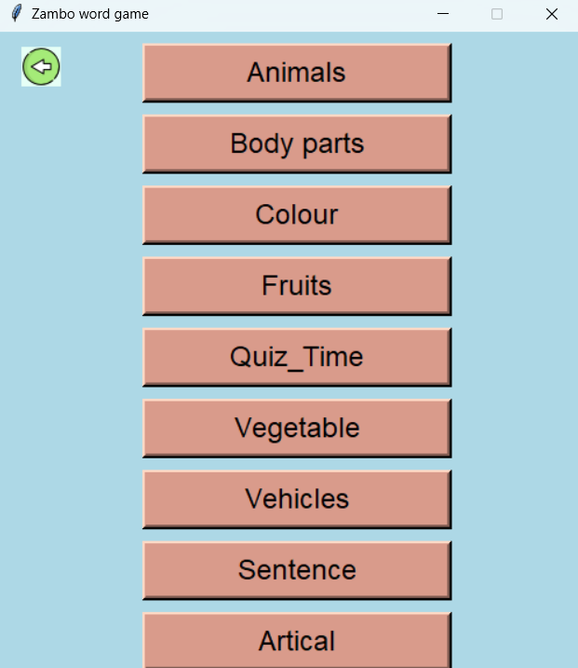
Basic Working Principle of the Portal
Step 1:- You have to open the program where you get JUMBLED WORD GAME
Step 2:- Select the given option which you want to like play with word

Slide 10
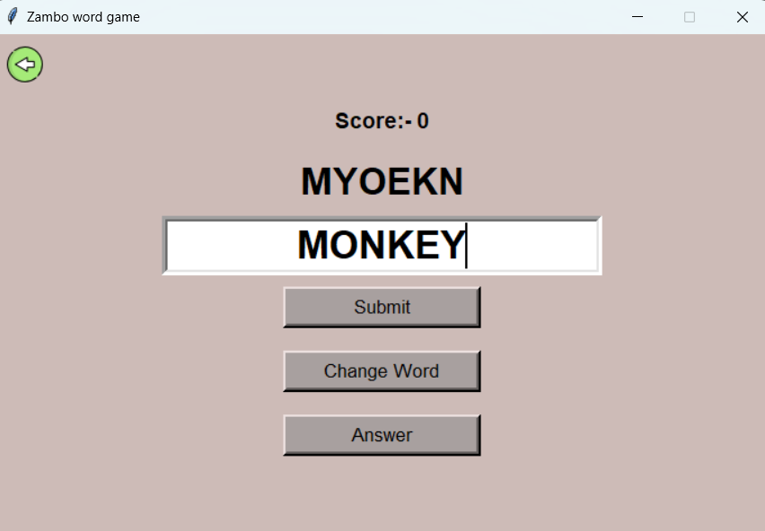
Basic Working Principle of the Portal
Step 3:- Then select particular section then you will go on that word world and start to play game.

Slide 11
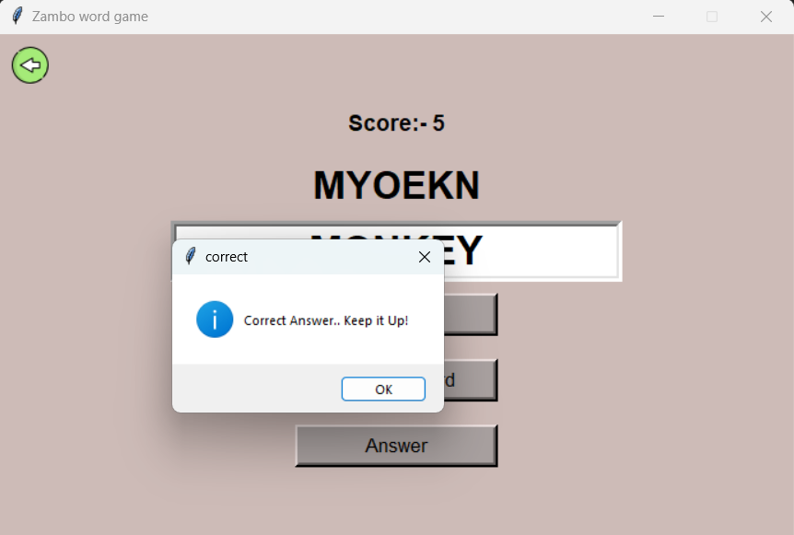
Basic Working Principle of the Portal
Step 4:- If you correct the given following jumble word
then you have got score ,which you
use in next step .

Slide 12
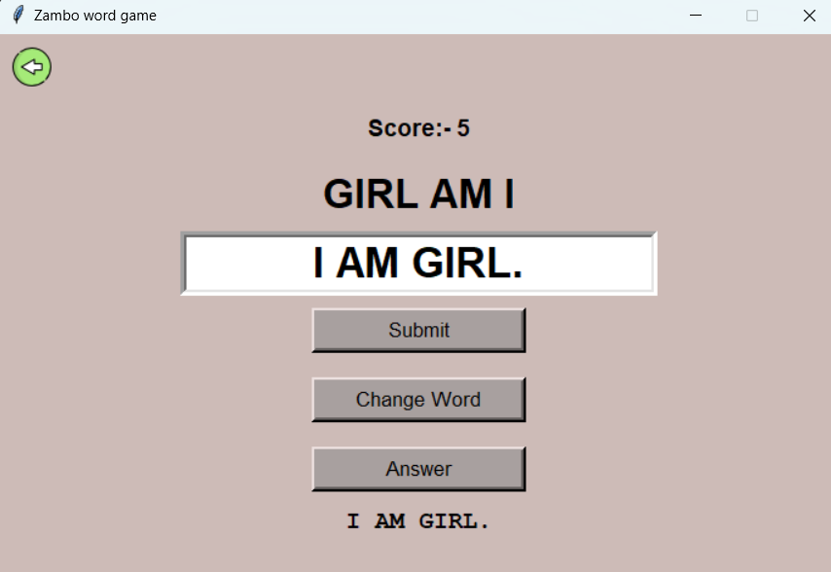
Basic Working Principle of the Portal
Step 5:- If you don’t know answer then you
use your score on to see the answer
In each answer there will be 5points
of score is decrease

Slide 13
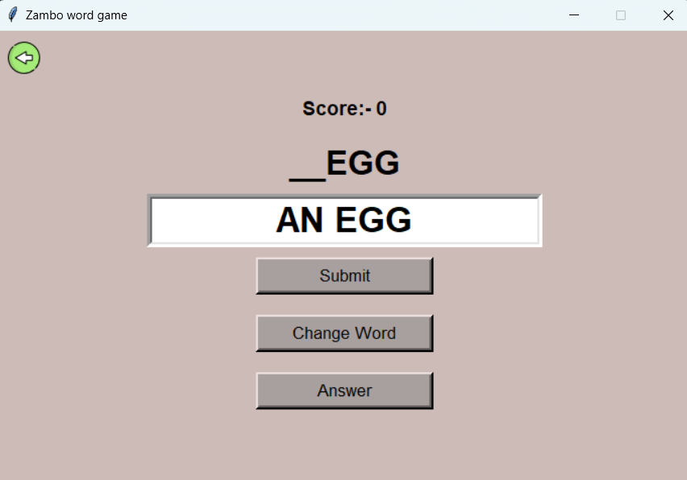
You will get many option here:-
You can practice your article
APPLE = AN APPLE
CAR = A CAR
EGG= AN EGG

Slide 14
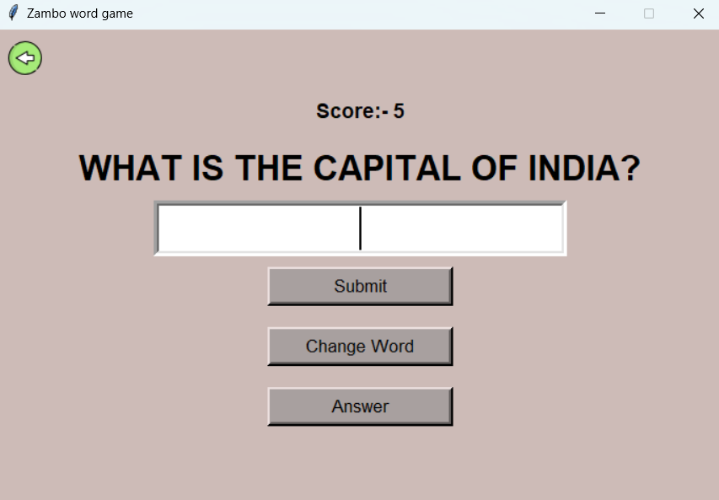
You will get many option here:-
You can also check your general knowledge
National flower = Lotus
National bird = Peacock
National fruit = Mango

Slide 15
You will get many option here:-
You can practice your sentence here
Is here my pen= Here is my pen.
Going to market am I = I am going to market.
My car is this= This is my car.

Slide 16
Conclusion
Learning new words and understanding
Students can learn new words and understand the meaning of these words through the game ,improving overall reading comprehension skills.
Practicing word recognition and meaning

Slide 17
Future Work
Building vocabulary through an engaging game
The jumble words game final project encourages students to learn new words and build their vocabulary by engaging in an entertaining game.
Developing an understanding of word relationships
It helps to related the words to another by providing a visual representation of the words they are learning.
Improving spelling and pronunciation
The jumble words helps to improve their spelling and pronunciation of the words they are learning.

Slide 18
Reference
[1] https:www.grammarly.com
[2] https://www.sciencekids.co.nz/quizzes/wordscrambles/earth.html

Slide 19
Thank You……!

